Slide 1
The Operations Framework
From an empty folder to a system that keeps itself true
A step-by-step start · about ten minutes
MeshPro × Expectus
Notes:
The base package is free and MIT licensed. This walkthrough takes someone from nothing to a working, self-checking operations layer in about ten minutes.

Slide 2
What you have in ten minutes
Not a plan for a system. The system, running against your own notes.
3
7
4
10
roles, compiled from written
contracts into runnable agents
workflows — five of them keep
the vault true by themselves
generators, so nothing on the
page is ever typed by hand
checks that fail the build
when a stated number is untrue
And the thing none of the counts show: a page that refuses to state a number it cannot prove.
Notes:
The counts matter less than the last line. The check is what separates this from a folder of documents.

Slide 3
Before you start
Three things, and two of them are optional.
Python 3.10 or newer
The generators and the check are plain Python. Nothing else is required — no account, no server, nothing phones home.
Obsidian — optional
The vault is a folder of markdown files. Obsidian just makes it comfortable to read and write. Any editor works.
Claude Code — optional
Point it at the same folder and the three roles are there waiting, already knowing the rules.
Notes:
Deliberately short. Anything that needs an account before it can be tried is something people do not try.

Slide 4
1
Get it, and point it at a folder
One command. The folder does not have to exist yet.
git clone https://gitlab.com/meshpro/consulting/ai-ops-framework.git
python ai-ops-framework/install.py "C:\work\my-vault"
What the installer does, in order
1. Makes twelve folders, each with a note saying what belongs in it
5. Builds the workflow register from the workflow notes
2. Writes the contract every AI session will inherit
6. Builds the page from everything
3. Installs five templates, three roles, seven workflows, two skills
7. Runs the check and tells you what is untrue
4. Compiles the role notes into runnable agents
Idempotent: run it again after any change and everything downstream comes back into line. It never overwrites a note you have edited.
Notes:
The idempotence matters more than it sounds. It means the installer is also the repair tool.

Slide 5
2
Look at what it made
Eight folders with one job each, and one file that governs everything.
The folders
CLAUDE.md — the contract
00 - Inbox — anything not yet filed
01 - Company — decisions, roles, workflows
02 - Work — what you are actually doing
03 - People — colleagues, customers, partners
04 - Knowledge — true regardless of this week
05 - Operations — the generated picture
06 - Daily — the day log, never a source
_Templates — the shapes notes are made from
The rules every session reads before it does anything: where each kind of fact lives, what frontmatter every note carries, the two marks a workflow gets, and the list of things that are never automatic — publishing, sending, deploying, spending, deleting.
It is yours from the moment it is installed. Change how you work, change this file, run the installer again.
Notes:
One job per folder is what makes routing decidable. If you cannot say which folder a fact goes in, the fact is not clear yet.

Slide 6
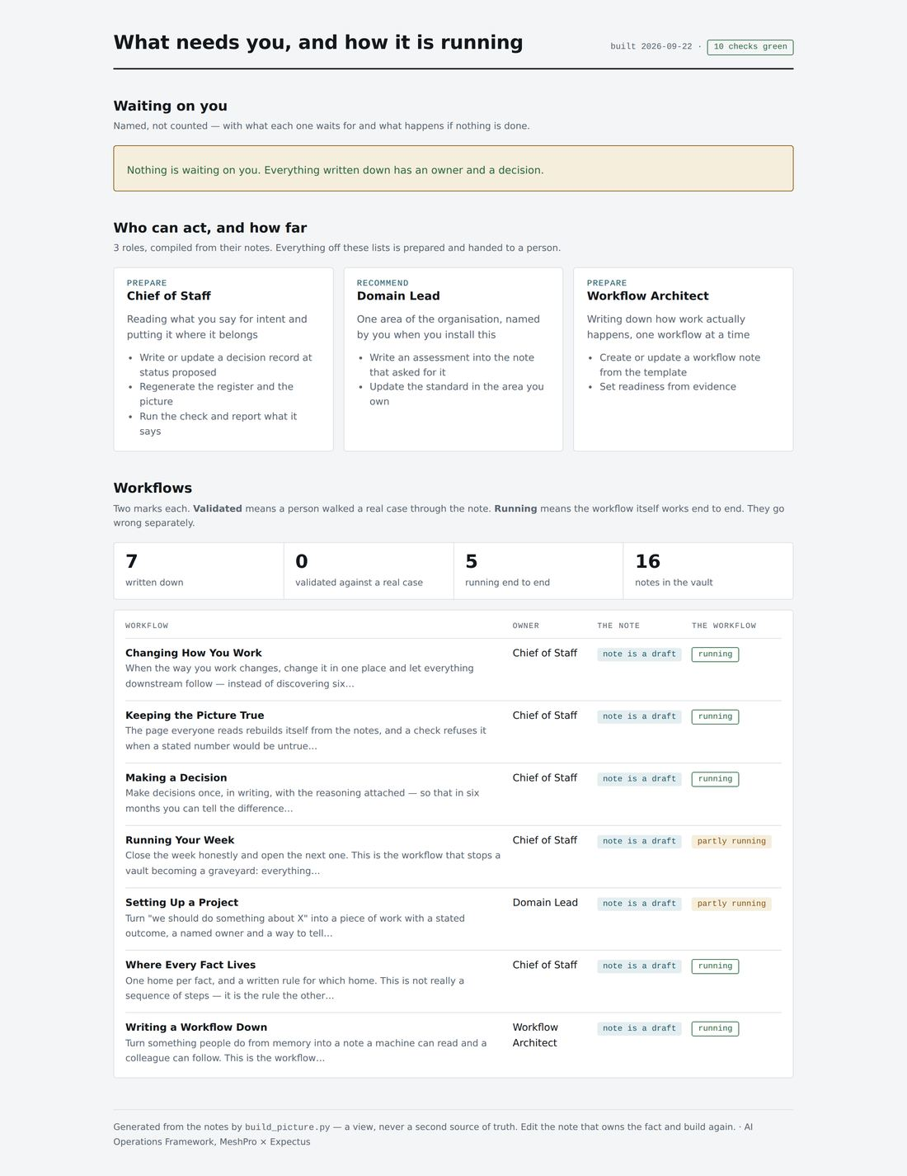
3
Open the page
05 - Operations/picture/index.html — a plain local file.
Nothing is waiting
On day one the panel is empty and says so. It fills as you work — and every line in it is generated, never remembered.
Ten checks, green
The badge at the top is not decorative. The page cannot claim a green check the check did not produce.
Notes:
This is the moment the idea lands: the page was not written, it was derived. Nobody will ever have to update it.

Slide 7
4
Rename the Domain Lead
The first thing to do, and it takes a minute.
A role called "Domain Lead" belongs to nobody
Then run the installer again
Open 01 - Company/Roles/Domain Lead.md and rename it for one area you actually have: Delivery, Engineering, Finance, Support — your words, not ours.
The role note is the source; the agent is compiled from it. Edit the note, re-run, and the agent changes with it. Never edit the agent.
Three roles is the base. Most organisations end up with five or six — and every one you add should answer the question:
“What would be wrong if this role did not exist?”
Notes:
Nine executives is what overwhelms a new user. Three that are actually yours beats nine that are ours.

Slide 8
5
Write one workflow down
Ask Claude to do it. The Workflow Architect asks five questions.
1
2
3
4
5
Who starts it?
What do they need to begin?
Where does it stop?
Who does it wait on?
What happens when it goes wrong?
The fifth is the one everyone skips, and the one that makes the note worth having. A workflow without exceptions describes a machine, not an organisation.
Write the current state — including the part where someone copies a number between two screens. An aspirational diagram is worse than none: people act on it.
Notes:
Two marks go on every workflow: is the note validated, and does the workflow run. Only a person can set the first.

Slide 9
6
Break it on purpose
Two minutes that tell you whether any of this is real.
python .ops/scripts/check.py .
Mark a workflow validated with no date
FAILED: a claim with no date is not one
Edit a role and skip the rebuild
FAILED: the agent is older than its role note
Change a note after building the page
FAILED: changed 12 minutes after the picture was built
Make a folder nobody declared
FAILED: either add it to the contract or file its contents
Every failure names the note to fix and never the output. Fix the source, build again, green.
Notes:
This slide is the whole pitch. Documentation that cannot be wrong is the only kind worth automating against.

Slide 10
7
Run your week
The workflow that stops a vault becoming a graveyard.
What finished
What has gone stale
At most five for next week
Gathered from the week's notes — a list, not a feeling. The record you will want in three months when somebody asks what happened.
Everything untouched for three weeks. Agents read status as fact, so a stale draft is misleading rather than merely old.
Five is the cap because twelve was never going to happen. The other seven are being deferred whether you write them down or not.
Step four is the only one that cannot be deferred: every stale thing gets promoted, archived or dropped. A list you look at without acting on trains you to ignore it.
Starting itself on a schedule is the Rhythm package. In the base, you start it.
Notes:
Honest about its own gap — which is also how the add-on package sells itself.

Slide 11
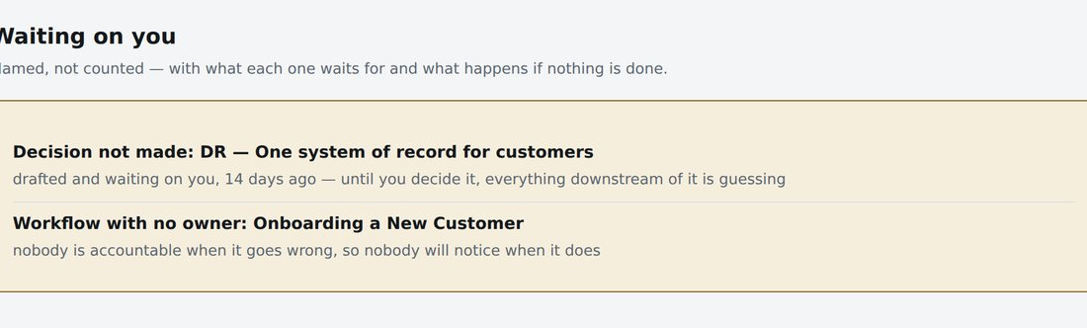
A fortnight in
Work that cannot move without you is named — not counted.
Each line says what it is, what it waits for, and what happens if you do nothing. Nobody wrote this list and nobody has to remember to update it — it is derived from the notes every time the page is built.
A count is not a notification.
Notes:
This is drawn from a real failure: nine written messages sat unsent for eleven days while a dashboard displayed the number five.

Slide 12
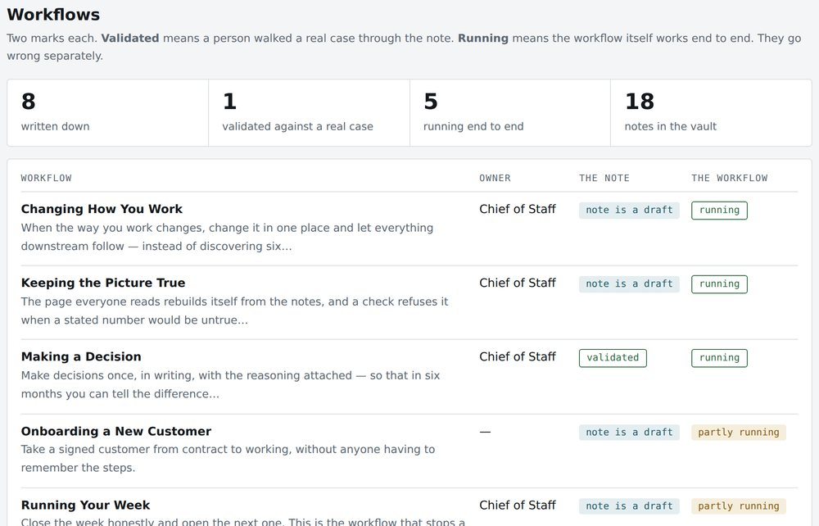
And the two marks on every workflow
Whether the note is true, and whether the workflow runs. They go wrong separately.
The note
Validated means a person walked a real case — and a real exception — through it. An agent may never set this.
The workflow
Running means it works end to end today. Partly means a manual step or a missing piece, and it must say which.
Notes:
Eight workflows, one validated, five running. A documented organisation is not the same as a working one, and the page says so.

Slide 13
The four rules it enforces
Everything else is implementation.
1
A fact has exactly one home
2
Every surface is generated
Two places is how an organisation ends up with two answers and no way to tell which is current.
A page nobody could regenerate is a page that will eventually lie.
3
A check refuses a false claim
4
Only a person commits
Not a warning — a failure. The build stops.
Agents prepare. Publishing, sending, deploying and deciding stay with you.
Notes:
If a buyer remembers one slide, this is the one to make it.

Slide 14
When the base is running
Six packages. Each one useless until it is — which is the point.
The Rhythm
The Board
The Customer Record
passes that run without you
your tracker, kept truthful
who has gone quiet, and why
Revenue
The Workshop
Two People
pipeline and outreach in your voice
agents inside your repositories
share it without sharing everything
The base is free and MIT licensed. You own the result outright — it lives in your repository, and nothing stops working if we stop talking.
git clone https://gitlab.com/meshpro/consulting/ai-ops-framework.git
MeshPro × Expectus
Notes:
Close on the command. The whole argument is that they can go and try it without talking to us first.

